Slide 1


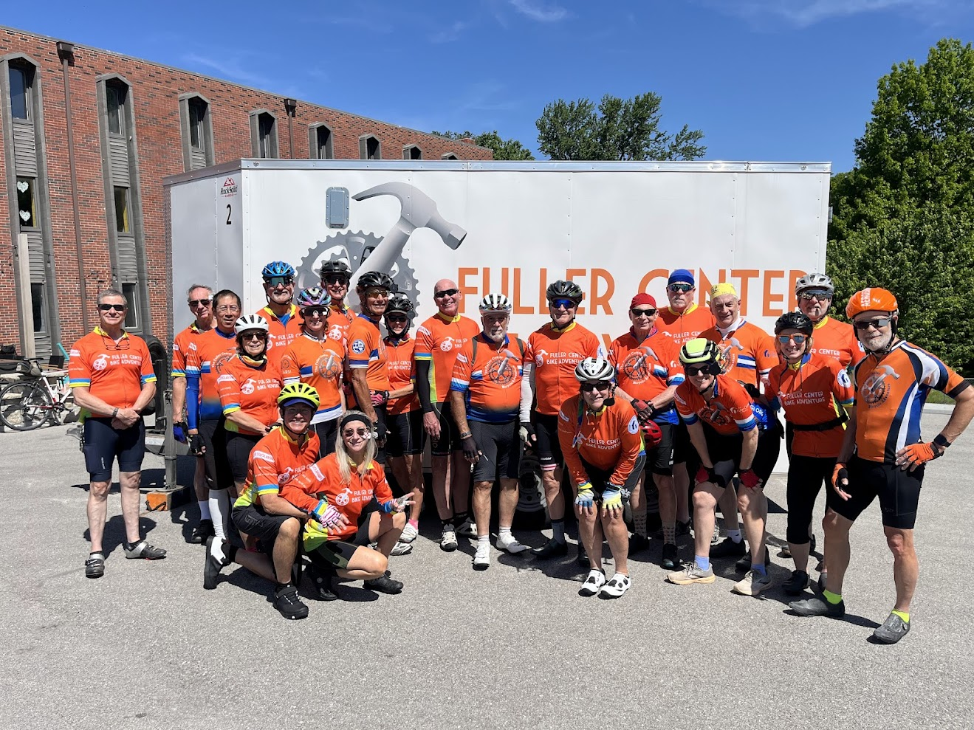
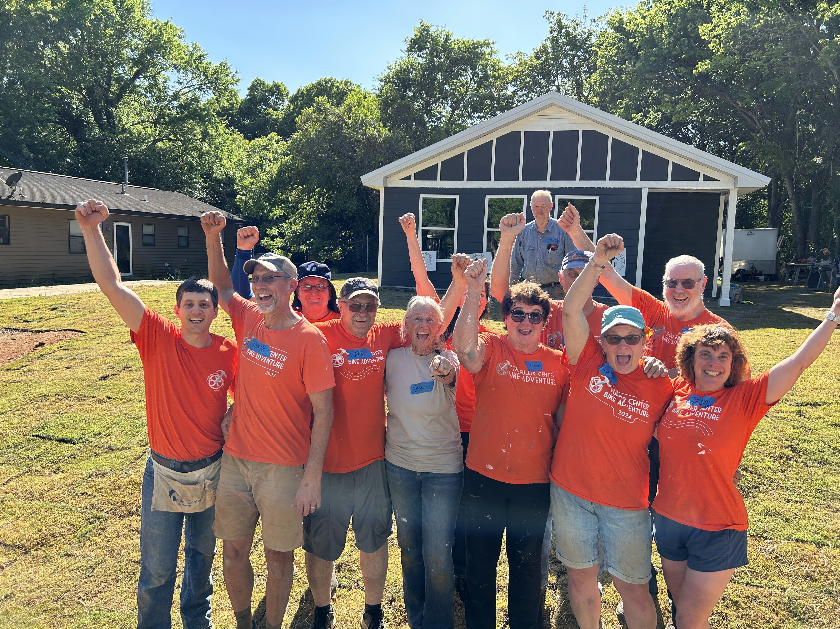
The Fuller Center Bicycle Adventure
2027

Slide 2
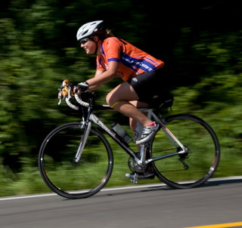
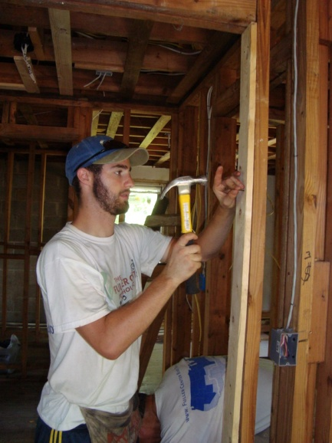

What is the Bicycle Adventure?
It began in 2008 as a cross-country cycling event to encourage people to join the movement to eliminate poverty housing
The ride raises money and awareness for the work of The Fuller Center for Housing
Brings people together from all ages and backgrounds to spend time together cycling, volunteering, serving, and praying

Slide 3
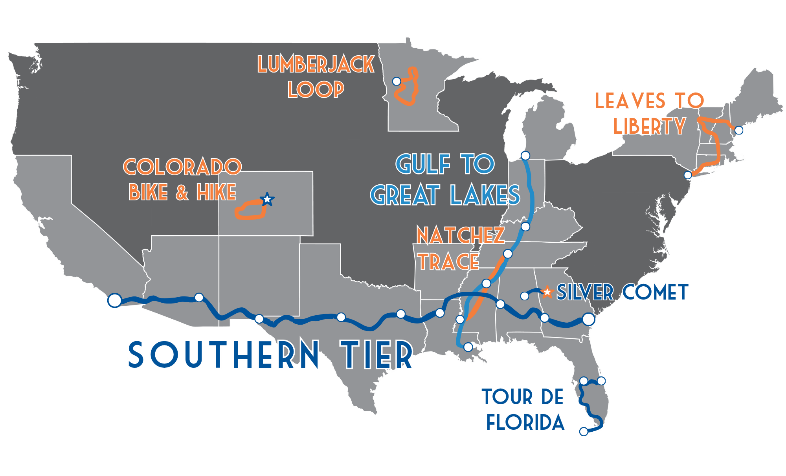
2027 Routes

Slide 4
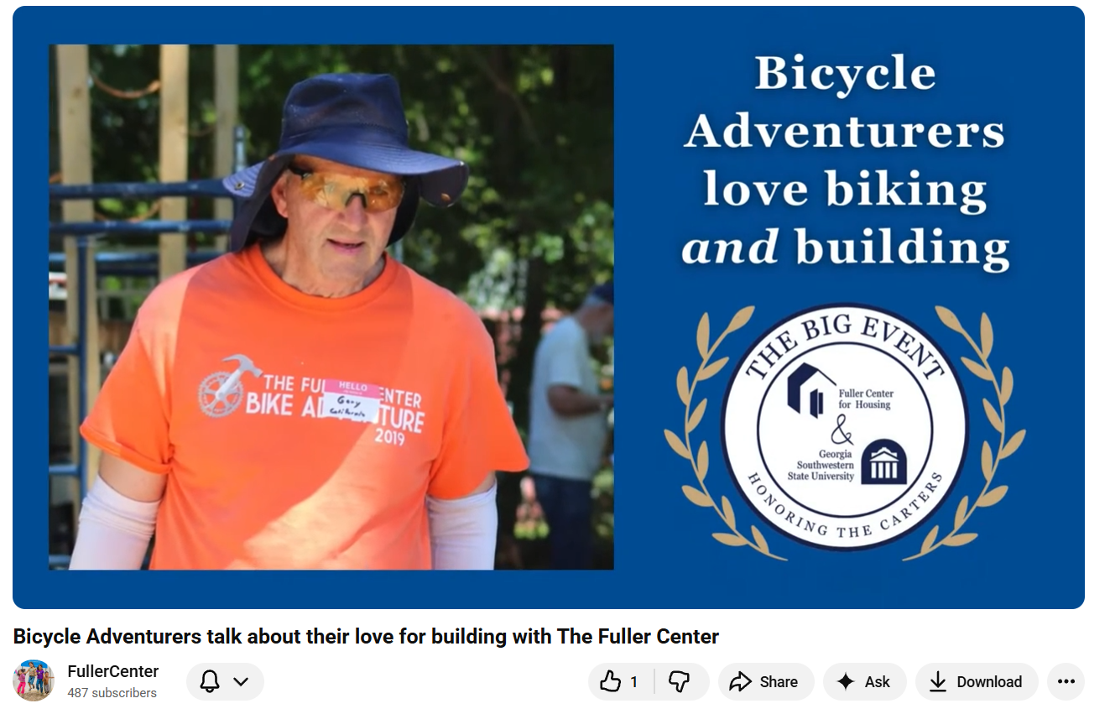
What is the Bicycle Adventure?
https://youtu.be/kFqB8jr2ycI?si=czMKuH8m_8cq7VQK

Slide 5
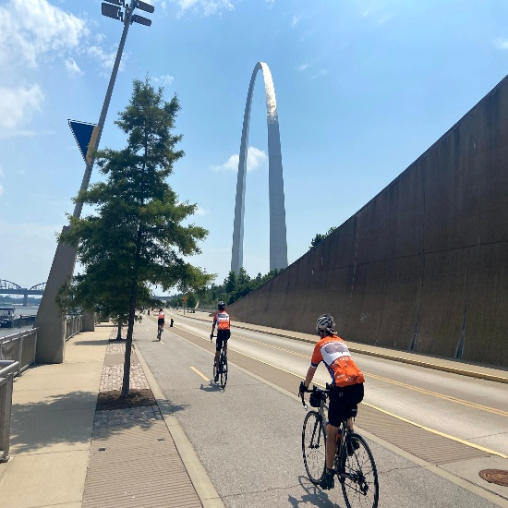
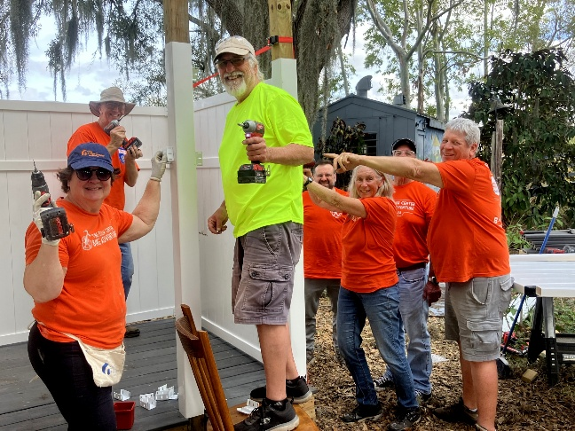
Why We Ride
To spread the word about our ministry
  We will speak to churches, civic groups, and the media about the affordable housing movement
To raise money for The Fuller Center
  Helps provide a simple, decent place to live for families in-need around the world
  Over $7.5 million raised since 2008
  This year’s goal = raise at least $1,000,000!
To put our faith into action
  Millard Fuller would say – “Faith without works is as dead as a doornail”

Slide 6
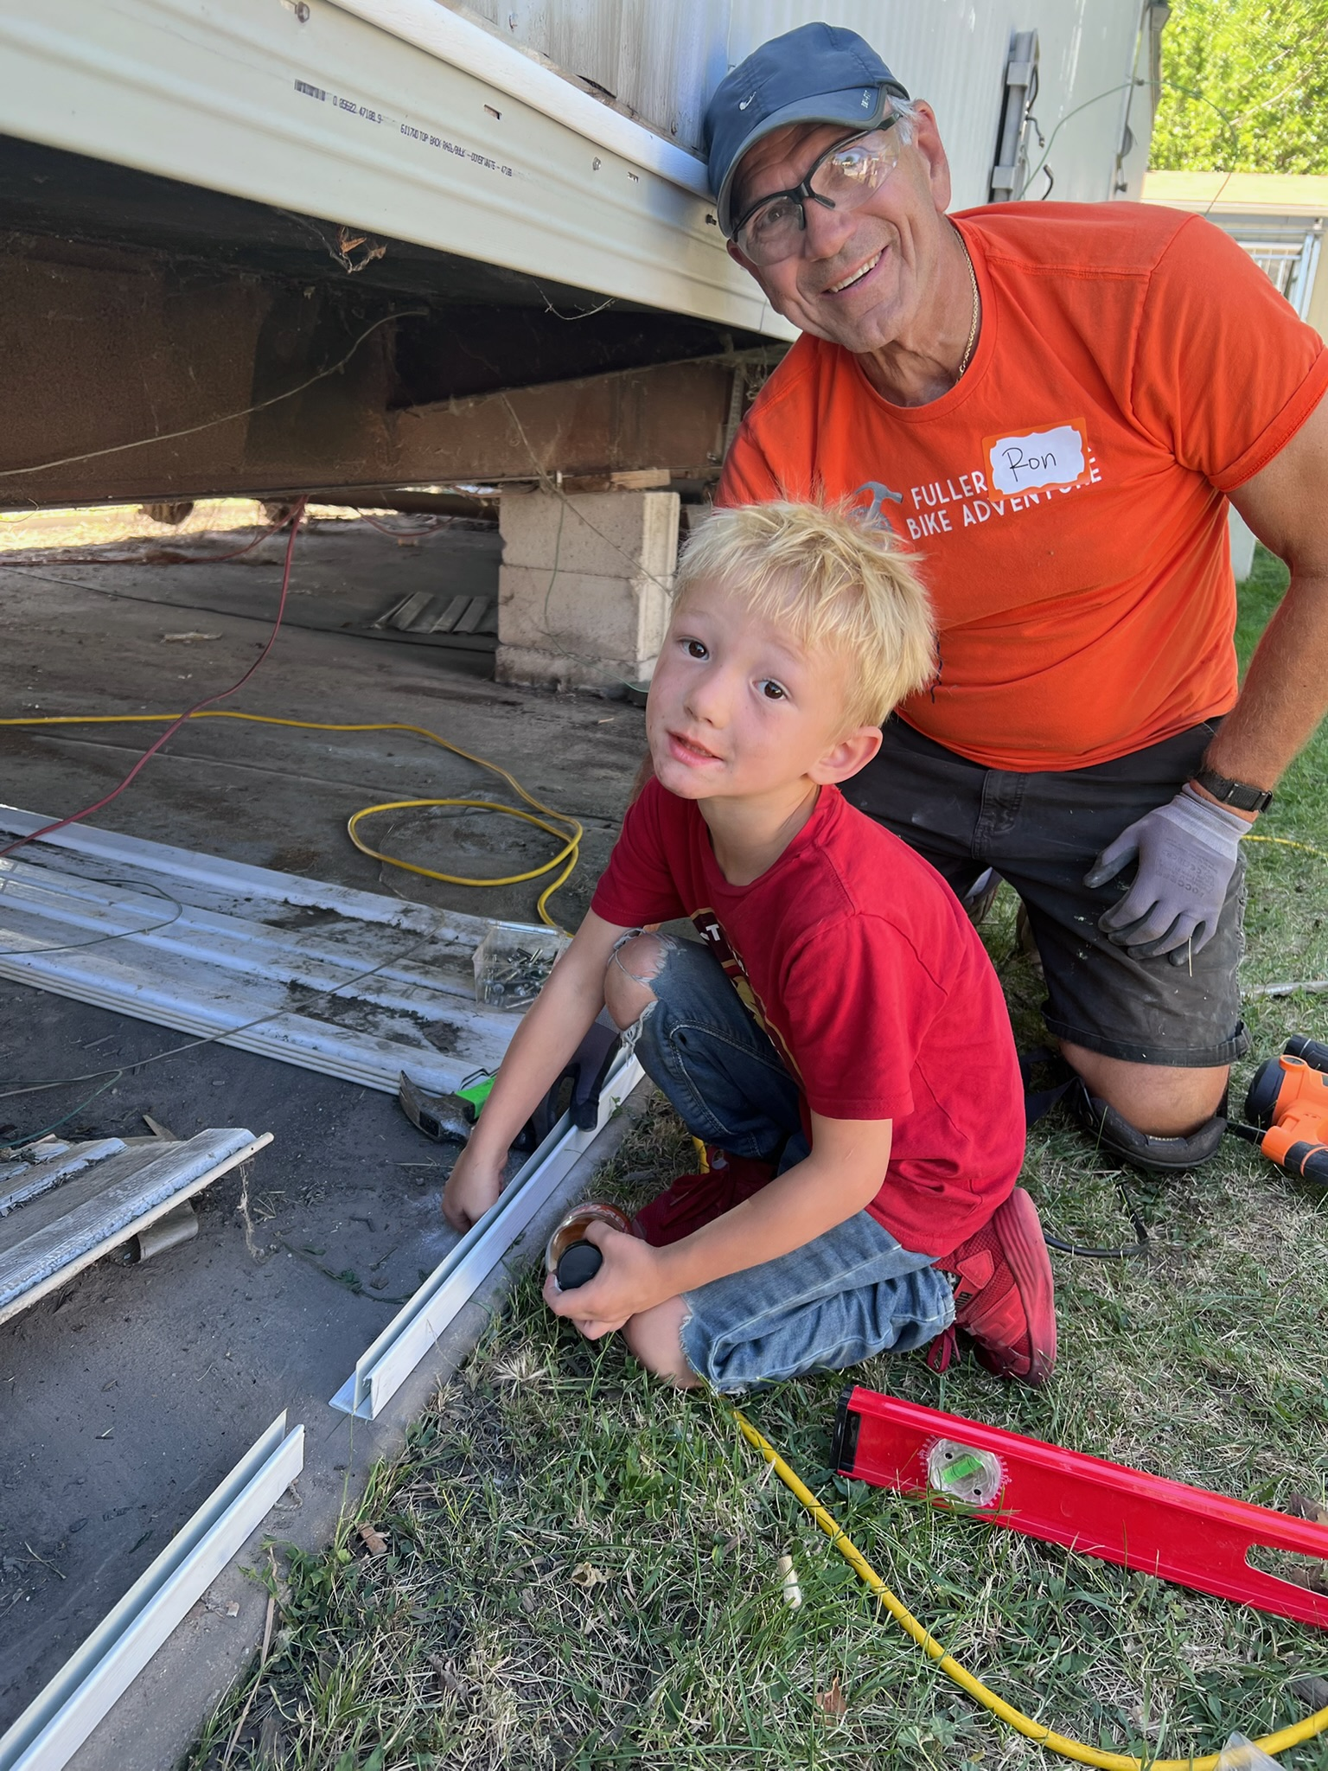
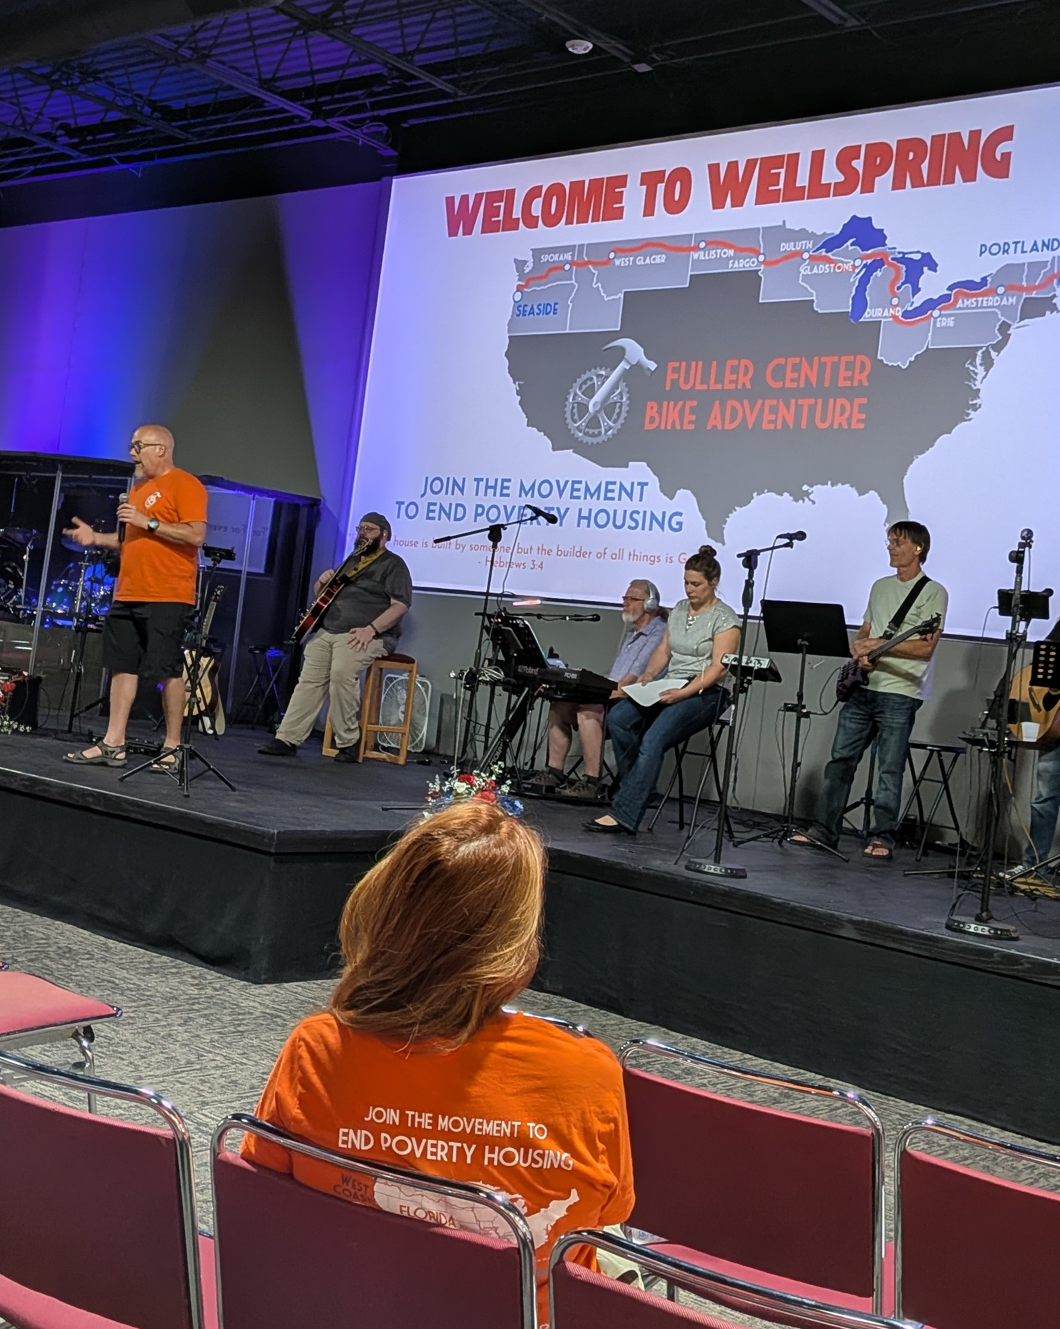
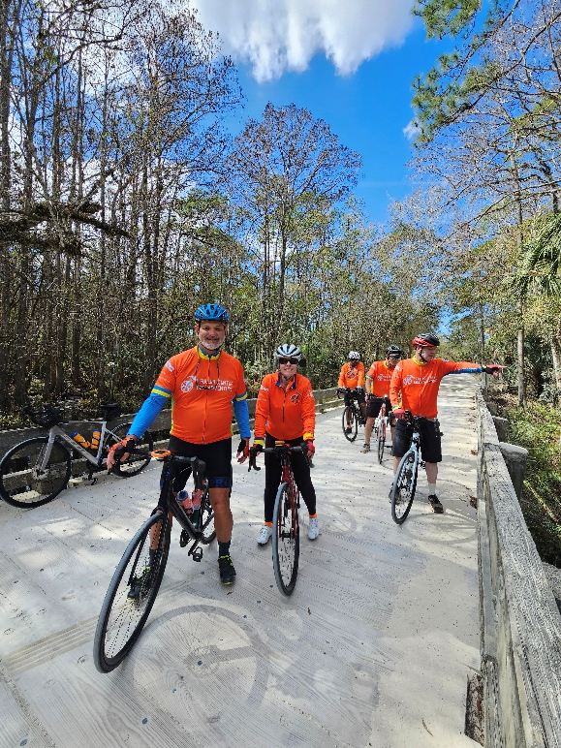
Bike Build Speak

Slide 7

What is The Fuller Center for Housing?
Christian. The Fuller Center, faith-driven and Christ-centered, is a non-profit organization that seeks to eliminate poverty housing around the world. We aren’t a church but we are a servant of the Church.
People-driven. We are not a government agency, and we do not use government funds for house building.
Grassroots. We believe that that the real work happens on the ground in communities around the world through our covenant partners, so a large, overseeing bureaucracy isn’t needed.
Collaborative. The Fuller Center builds with, not for, families in need. Partner families pay for their new or rehabilitated homes on terms they can afford - with no profit made and no interest charged. As their payments go toward work on other local houses, Fuller Center families become donors in their own right, demonstrating the principle that it is more blessed to give than to receive.
International. No location is too poor or too distant. The Fuller Center will go wherever it is called.

Slide 8
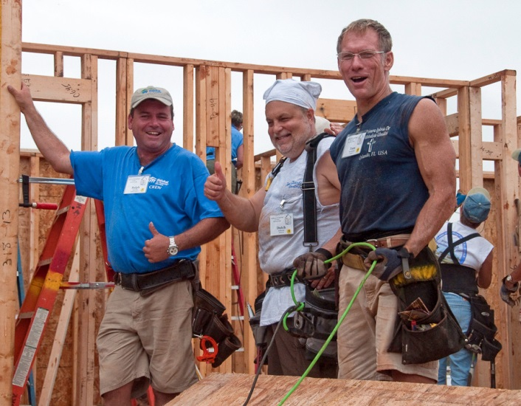
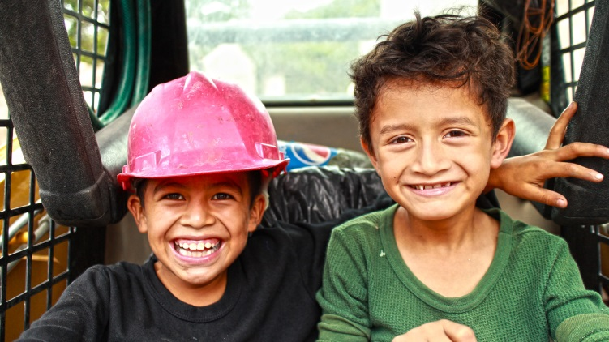
Brief History of the Fuller Center
The Fuller Center was founded in 2005 by Millard Fuller to continue the dream of eliminating poverty housing that began with his founding of Habitat for Humanity
The Fuller Center has established partner organizations in over 95 U.S. cities and in 20 countries on six continents.
The Fuller Center has provided housing for over 10,000 families since 2005

Slide 9
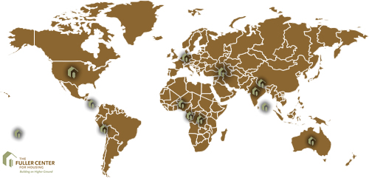
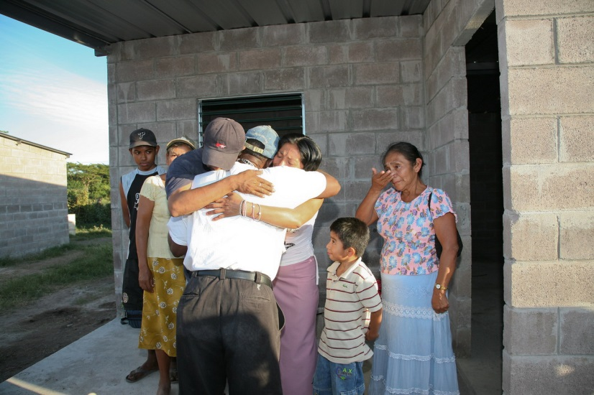
Worldwide Need for Housing
Today, 2.8 billion people – about 40% of the global population – live in sub-standard housing
In the US, housing affordability has gotten worse over the last 20 years pushing the need to some of its highest levels.
No project is too big or too small. The Fuller Center completed a community of over 130-homes in El Salvador with volunteers from around the world. At the same time, the small U.S. town of Lanett, Alabama built a house with the help of most of its residents.

Slide 10
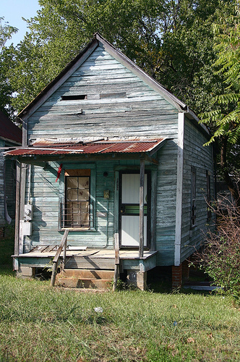
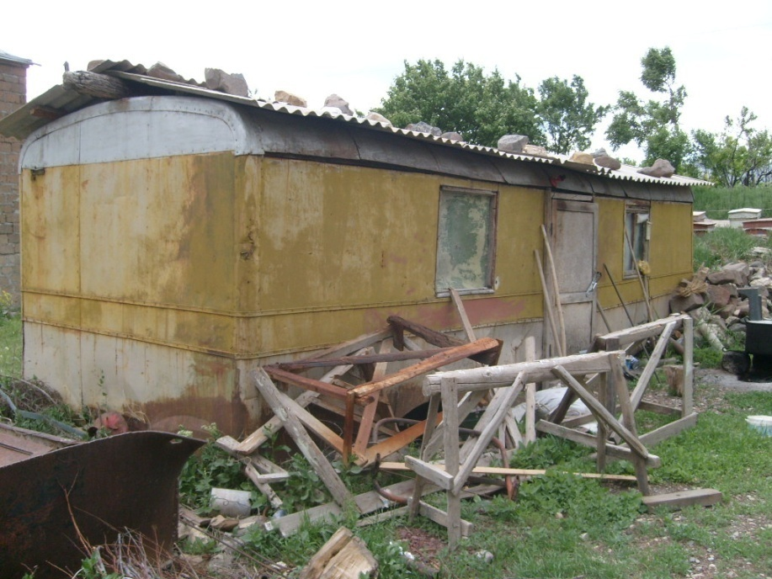
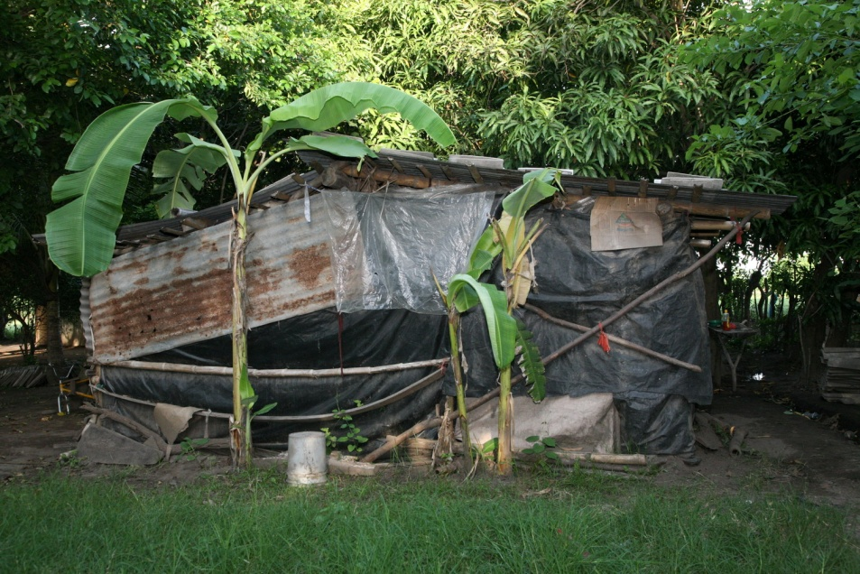
Worldwide Need for Housing
Substandard housing is an international problem
Armenia
United States
El Salvador

Slide 11
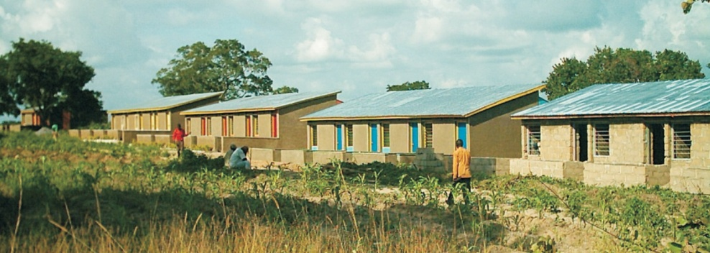
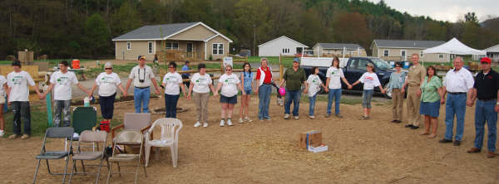
A Simple, Decent Home
Children who grow up in a decent home are healthier, perform better in school and have fewer behavioral problems
The benefits of decent housing, though, extend beyond individual families. Neighborhoods with a high level of homeownership are cleaner and safer than those with a prevalence of rental and derelict housing
When you improve housing, you don’t just strengthen families — you also build stronger neighborhoods and communities
A new neighborhood in Nigeria of Fuller Center houses where the 50th home was dedicated in 2009.
American volunteers join hands to celebrate the completion of another Fuller Center house

Slide 12

Join the Movement!
Join the Bike Adventure for a segment or the whole way as a rider or vehicle support person!
Tell others about the event
Sponsor my ride
Volunteer with your local Fuller Center Covenant Partner
Join a Global Builders mission trip to put the Fuller Center’s mission into action abroad

